Slide 1
Characterisation of reinforcement fabrics by fractal dimension
Dominik Piasecki and John Summerscales
Composites Engineering
MAterials and STructures (MAST) research group

Slide 2
Outline of talk
fractal dimension (FD)
previous use of FD to characterise composites images
experimental materials and methods
results
conclusions

Slide 3
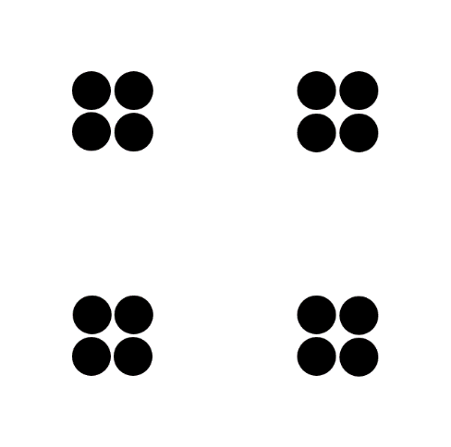
Indicative images and fractal dimension
Analysis in ImageJ with FracLac software
Image > Type > 8 bit
Image > Adjust > Threshold
Process > Binary > Make Binary
Analyze > Tools > Fractal Box Count (FD from Richardson plot)
0.0000 1.5501 1.7363 1.8370 1.9951
0 = point
1 = line
2 = area
3 = volume
one small black dot
one small white dot

Slide 4
FD box counting method
can be applied to both linear and non-linear fractal images,
applicable to patterns with or without self-similarity
cover the image with small boxes
count the boxes containing feature of interest
increase box size, and count ... repeat with larger boxes
plot detected area against box size
FD is slope of graph

Slide 5
Previous use* of fractal dimension to characterise composite images
Pearce PhD ~ permeability and strength vs FD
InGeCt in-mould gel coating ~ surface finish vs FD
Mahmood PhD ~ “Fibre distribution, characterised by [FD], can be used as a parameter to characterise the static and fatigue properties of fibre-reinforced composites tested in four-point bend”
* references on final slide

Slide 6
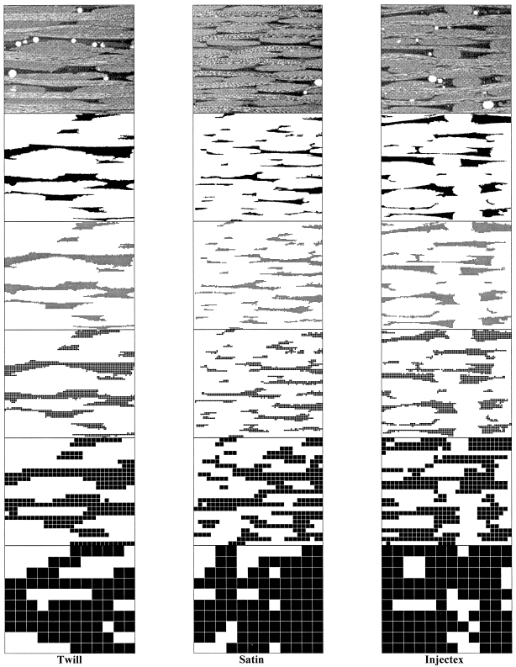
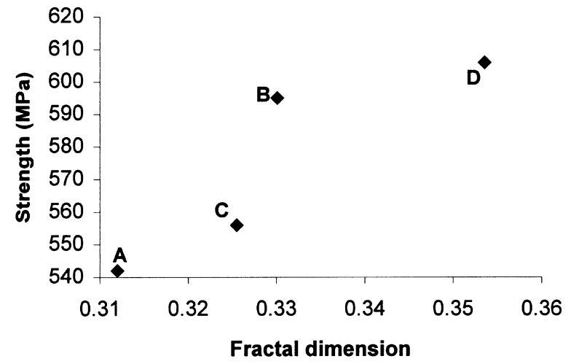
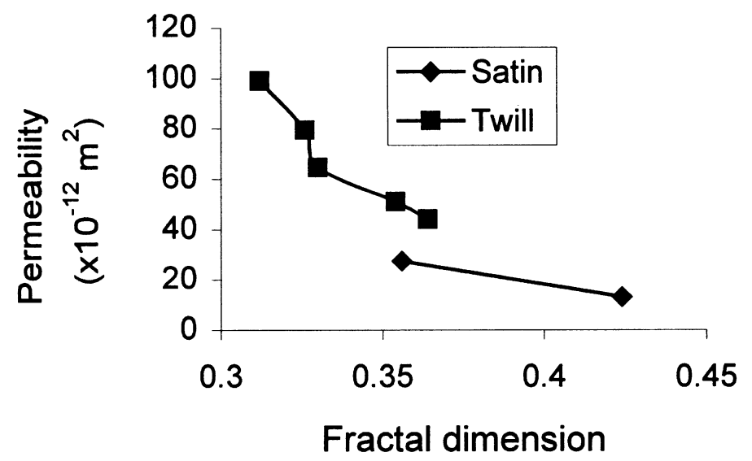
Pearce PhD ~ permeability and strength vs FD
(left) comparison of three Brochier fabrics
(centre) Carr fabrics weft strength
flow enhancement tows in weft
A 33%FET, B 20%FET, C 14%FET, D 0%FET
(right) permeability

Slide 7
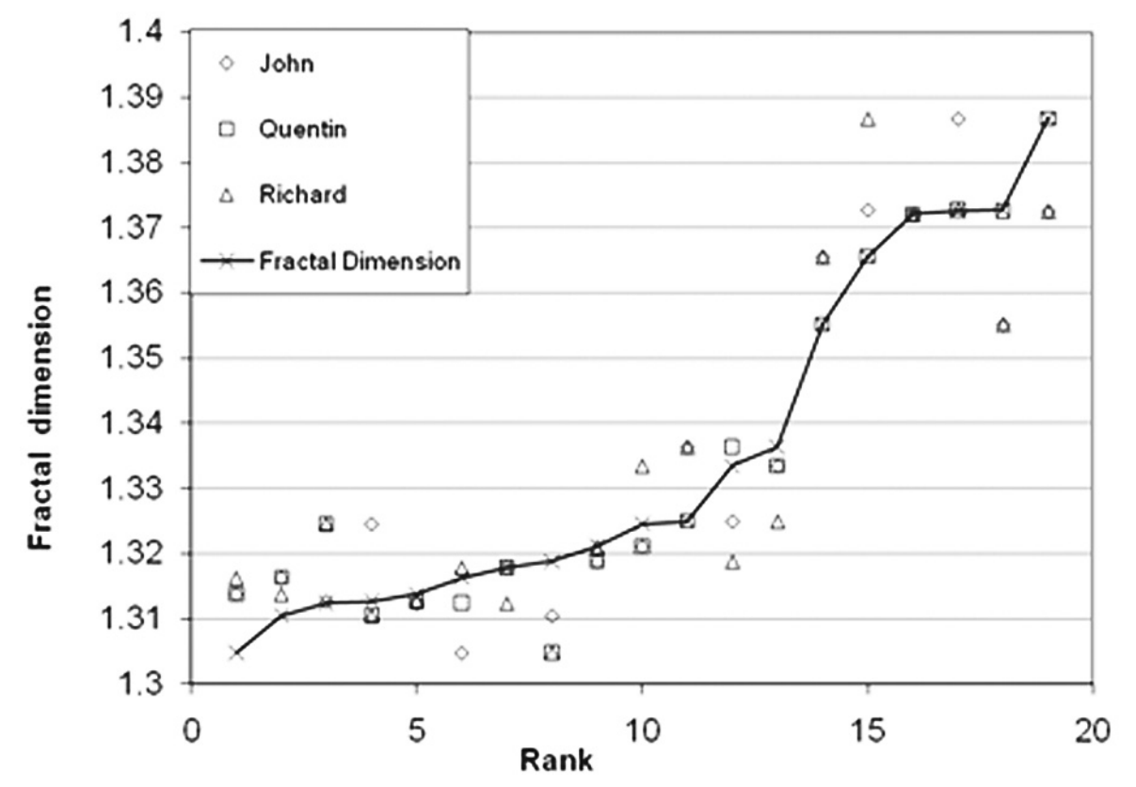
InGeCt in-mould gel coating ~ surface finish vs FD
FD from reflection from plate surface under controlled lighting
plates ranked by 3 staff in Plymouth
2 professional composites engineers (automotive/marine) asked to rate the plates and confirmed that the finish on the latter six would be unacceptable to the industry.
unacceptable finish
OK for industry

Slide 8
Characterisation of reinforcement fabrics by fractal dimension

Slide 9
Carbon fibre fabrics examined in this study
all fabrics woven by Carr Reinforcements
fabric style | areal weight | warp tows/m | weft tows/m
plain weave | 300 g/m² | 380 | 380
single tow twill (STT) | 320 g/m² | 380 | 420
double-tow twill (DTT) | 375 g/m² | 380 | 380

Slide 10
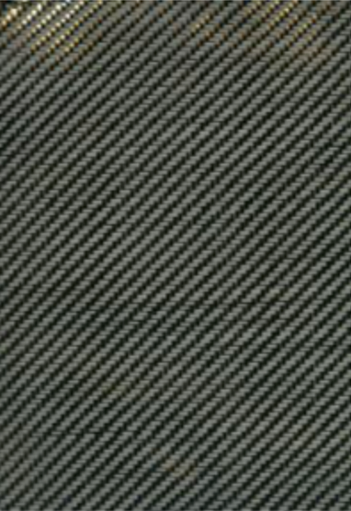
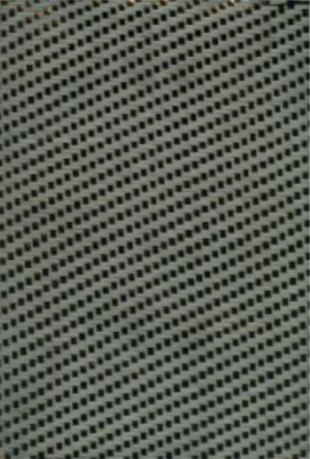
Carbon fibre fabrics examined in this study
plain weave single tow twill double tow twill

Slide 11
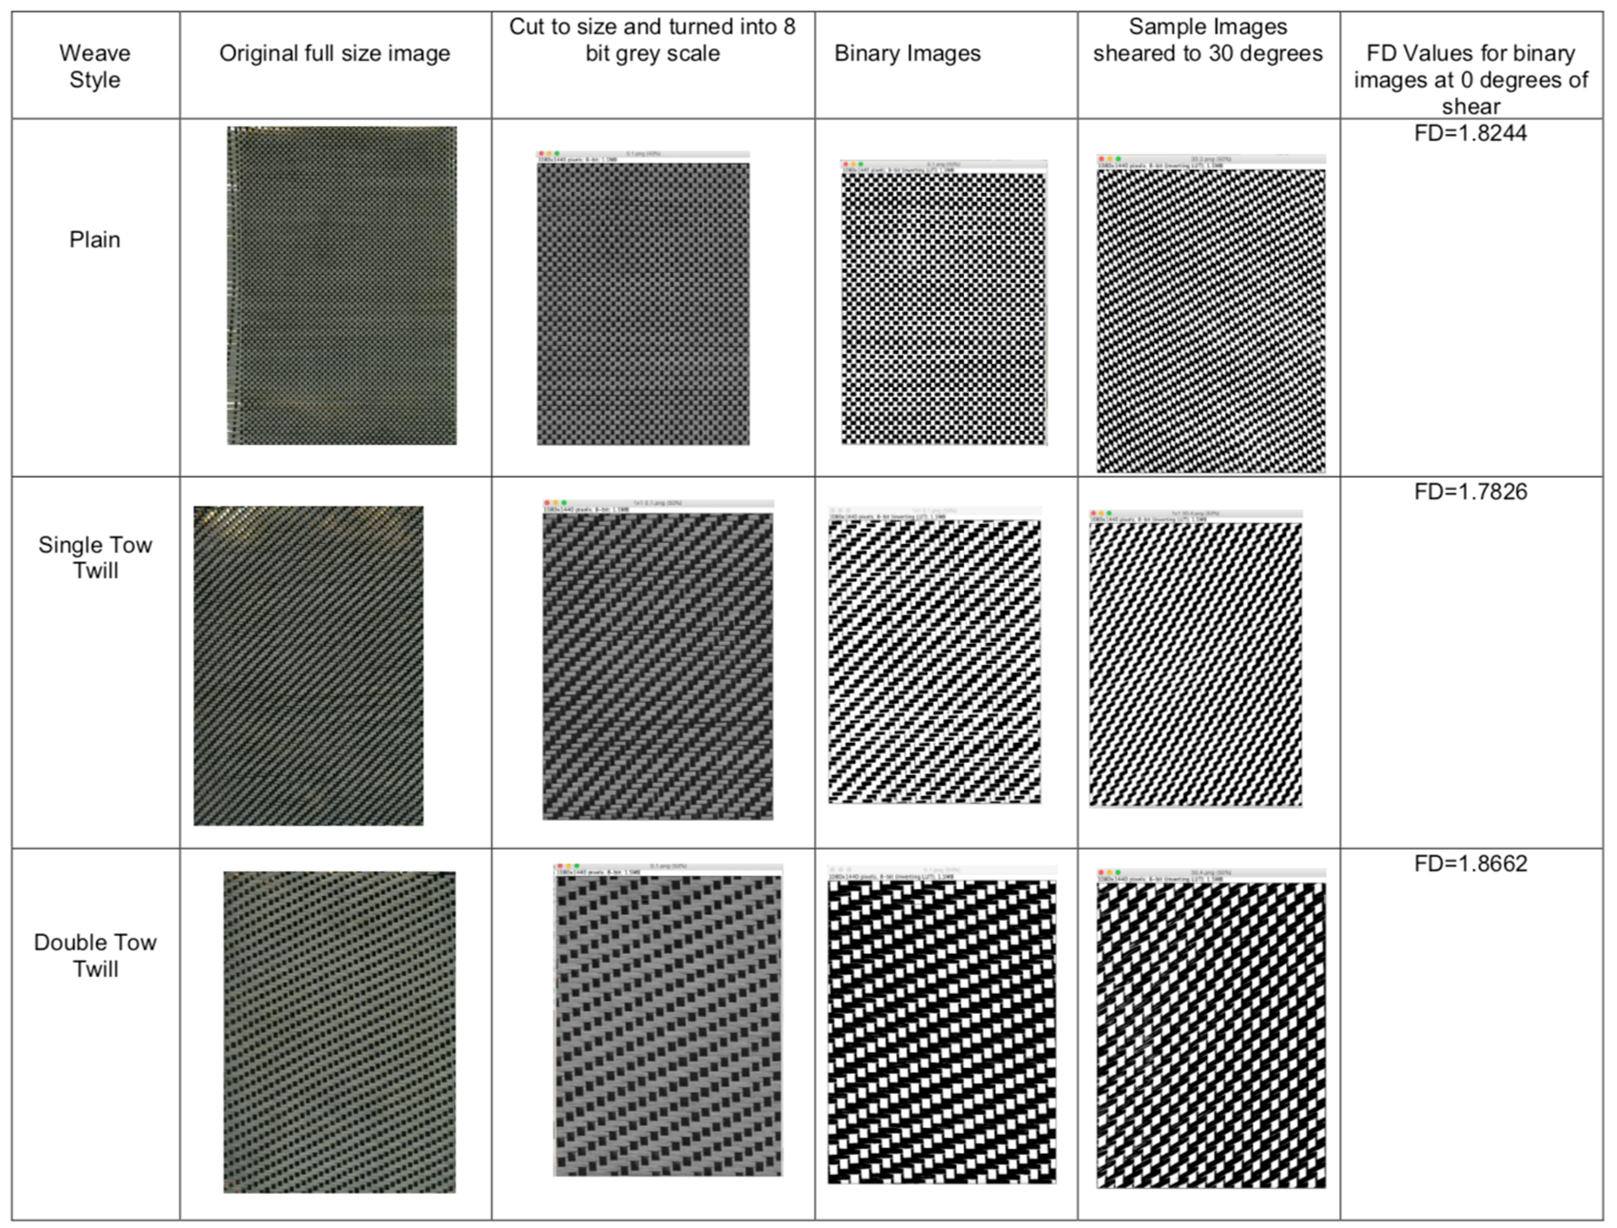
Fabric images
images acquired by high-resolution scanner

Slide 12
FD from separate images

Slide 13
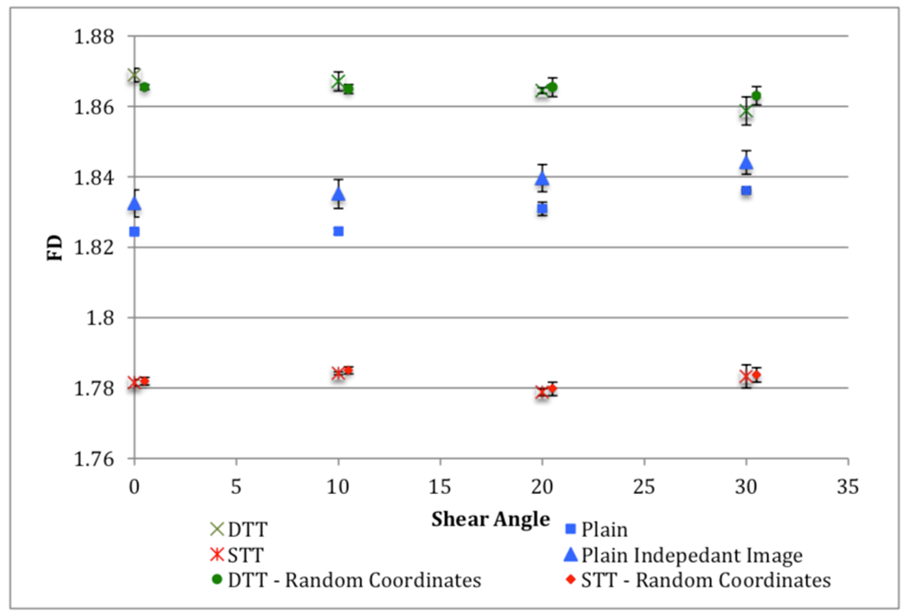
FD vs fabric shear angle
double tow twill
plain weave
single tow twill

Slide 14
Plain weave fabric curvature
inside of roll
outside of roll
FD increasing with shear angle not seen for twill fabrics

Slide 15
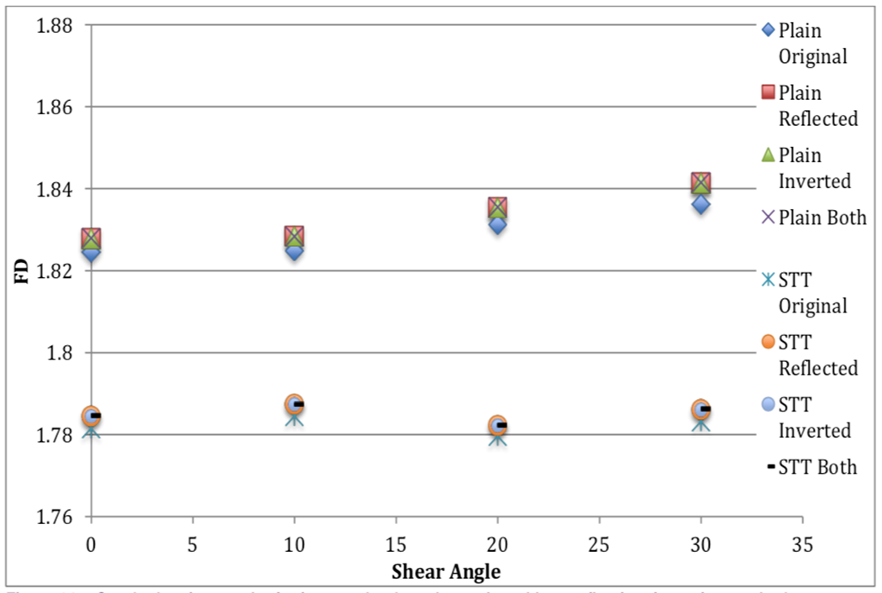
Digital inversion/reflection of images
FD consistent regardless of image orientation

Slide 16
Conclusions
fibre reinforcement fabrics can be identified using their respective FD values
no overlap between FD of different weaves, despite shearing to 30° in results from over 320 images.
FD values independent of inside/outside of roll
FD independent of reflection/inversion of images
potential for implementation in manufacturing quality systems

Slide 17
References for previous uses of FD
Pearce PhD ~ correlation to permeability and strength
NRL Pearce et al, Composites Part A, 1998, 29A, 829-837.
J Summerscales et al, J. Microscopy, 2001, 201, 153-162
InGeCt in-mould gel coating ~ correlation to surface finish
Q Labrosse et al, Insight, 2011, 53, 16-20.
Mahmood PhD ~ correlation to resin-rich volumes
AS Mahmood, IOP Conference Series: Materials Science and Engineering, 2018, 388 (conference 1), 012013.

